Slide 1

10 Water Conservation Tips
Bulacan Water District

Slide 2



1.
Monitor and Repair leaking faucets and pipeline in the house and in all establishments.

Slide 3
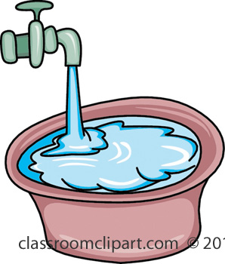
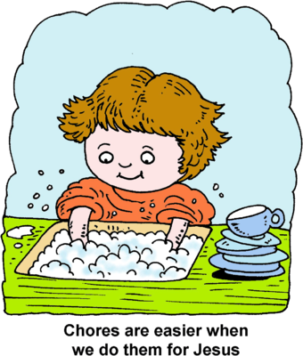
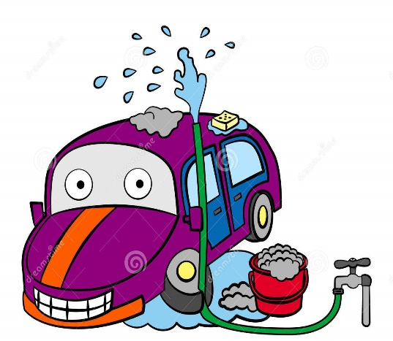
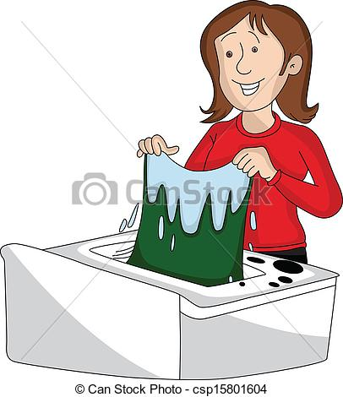

2.
Don’t let water overflow when laundering, washing plates, watering plants and cleaning vehicles.

Slide 4
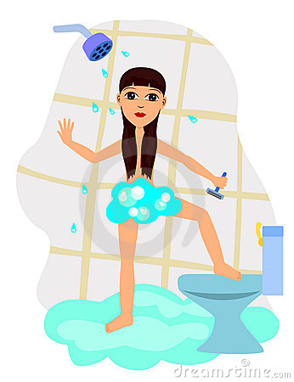
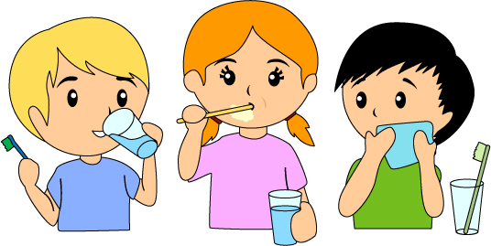
3.
Don’t let water run freely when shaving or brushing teeth. Use a glass instead.

Slide 5

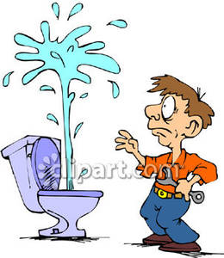
4.
Use the Water Tank Properly. Don’t let water overflow. Adjust the flush meter or float to the water level just enough for flushing.

Slide 6
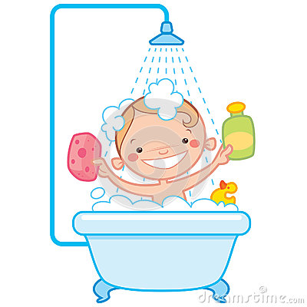
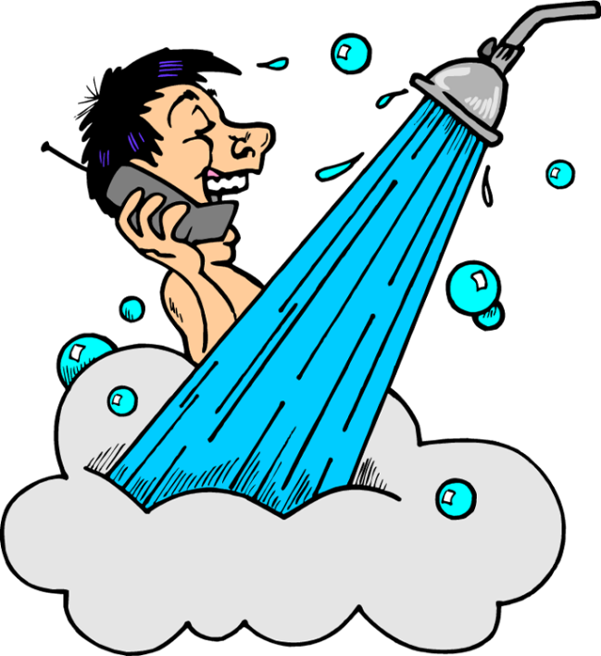
5.
Discourage Children from playing with water while bathing. Avoid taking long shower.

Slide 7
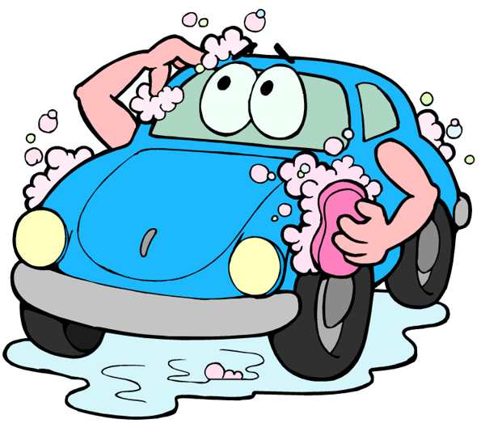
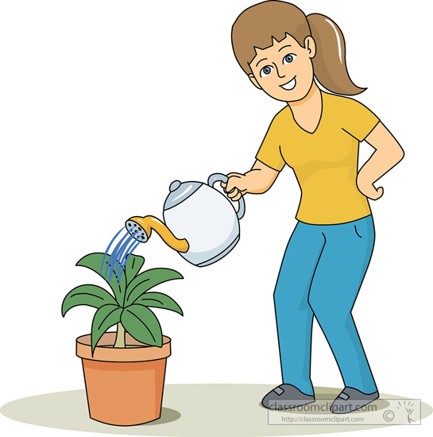
6.
Use laundry or plate rinse water for wetting the plants or cleaning vehicles.

Slide 8
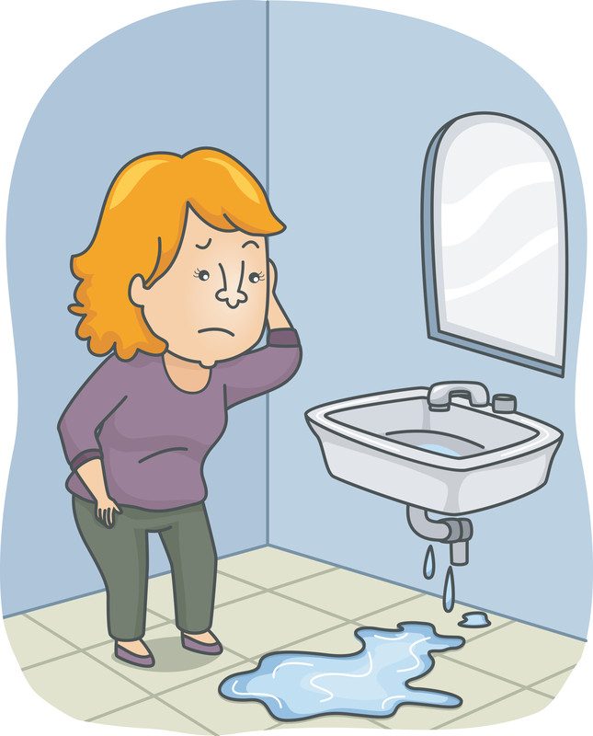
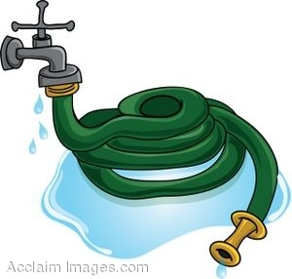
7.
Always check faucets in and outside the house. Double check at night before sleeping.

Slide 9
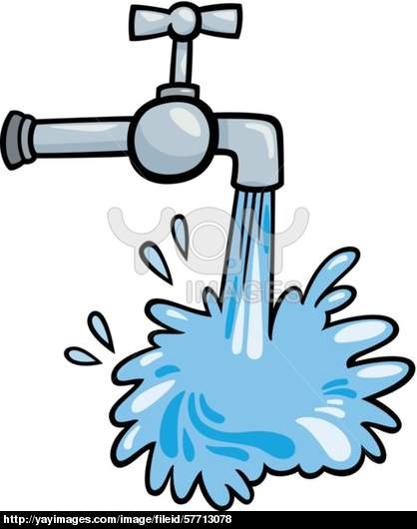
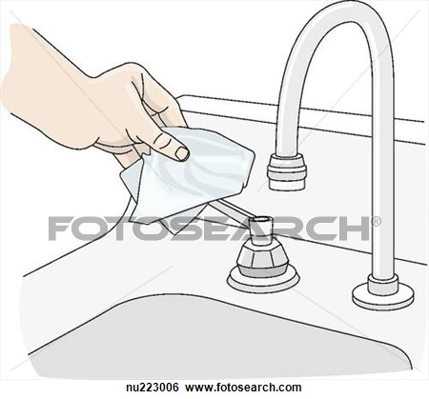
8.
During water interruption, make sure to close faucets to avoid wastage upon resumption of supply.

Slide 10

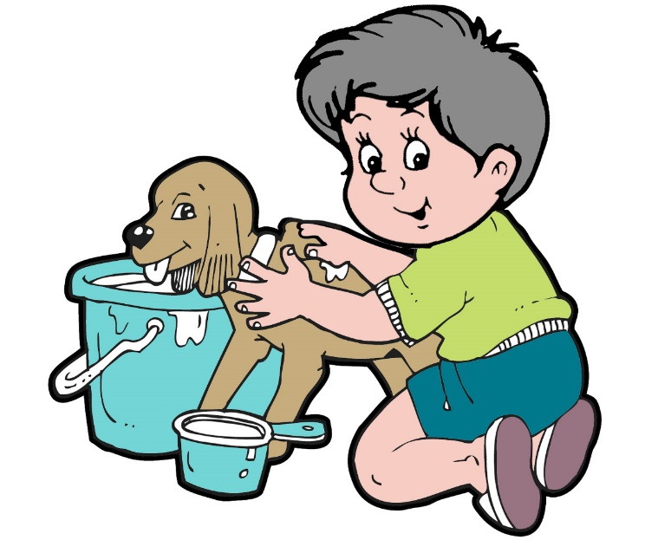
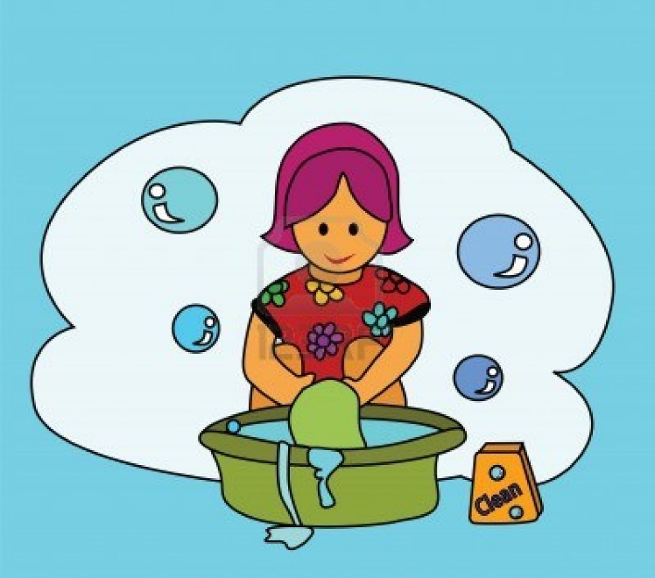
9.
Save rainwater in clean and covered containers and use it to clean surroundings, wash vehicles, clothes and rags, bathe pets and water plants.

Slide 11

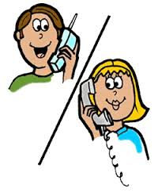
10.
Immediately report water meter and street leaks to the Bulacan Water District at
(044)792- 0191 or (044)668- 1499

Slide 12
Created by: wilson

